Slide 1
CSCE 623 In Class Day 07
Synchronous session

Slide 2
Agenda
Roll Call // Start Recording
Lessons learned from regression (Ch 3) that affect all ML
Overview Chapter 4: Classification
Learning Activity Directions
Worksheet Part 1 – Logistic Regression thinking & Discussion
Break
Worksheet Part 2 – Logistic Function Coding
Key points Discussion
Questions (content and project) & Dismissal

Slide 3
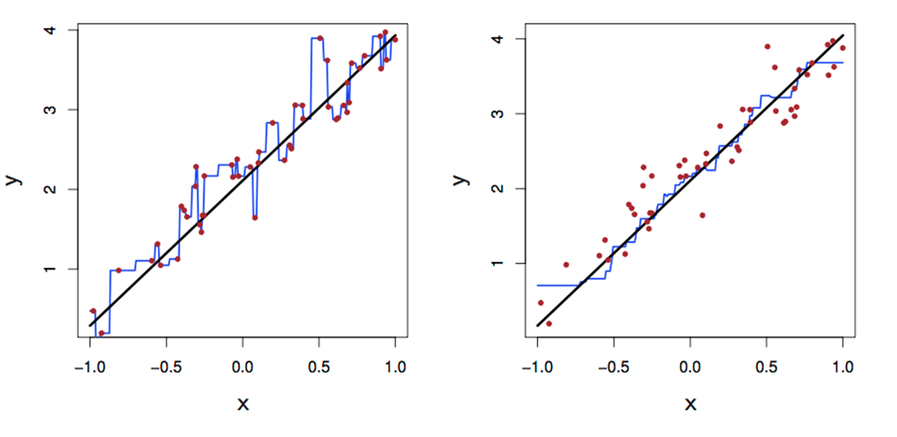
Lessons learned from regression: KNN
1D KNN for Regression; Choose the K
Low value for K Higher value for K

Slide 4
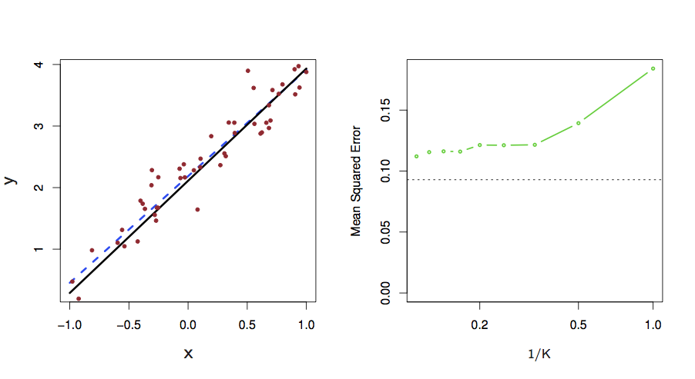
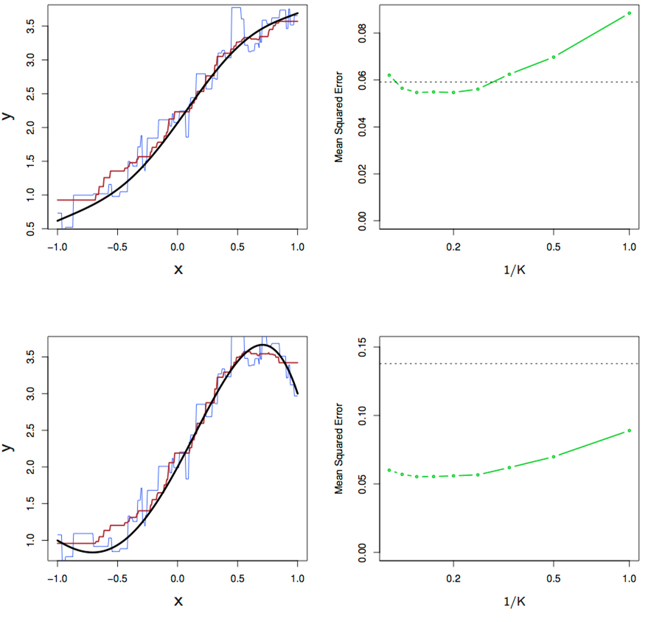
1-D KNN for regression
Simple phenomenon
More complex
Even More Complex

Slide 5
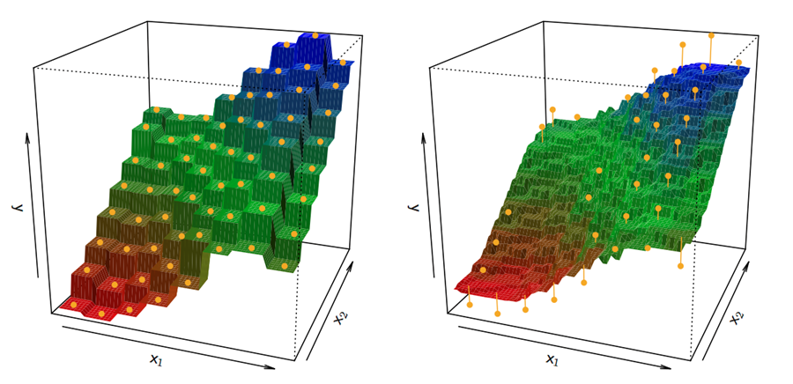

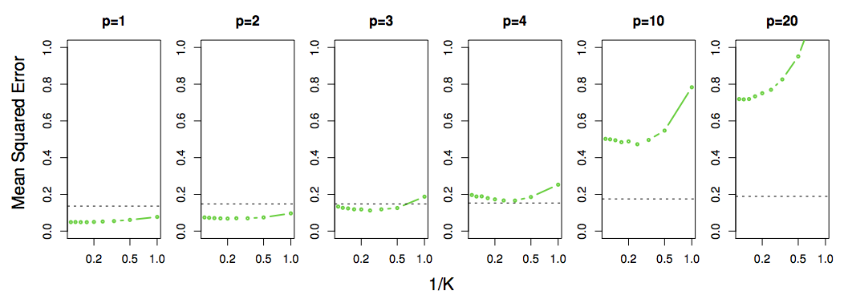
kNN is Not So Good in High Dimensional Situations
In this example, one feature is relevant & nonlinear, but additional features are irrelevant (noise)
Concept Check: Why does kNN perform ever worse than linear regression as we increase the number of (irrelevant) features?
This behavior is evidence of the phenomenon known as “The Curse of Dimensionality”

Slide 6
Questions on regression / Ch 3?

Slide 7
Overview for Classification
Classification: determining which category an observation belongs to
Basic Classifier Models
Logistic Regression (Day 07 )
Linear Discriminant Analysis (Day 08)
Quadratic Discriminant Analysis (Day 08)
Important Performance Measures for Classification (Day 08 & HW2)
Accuracy & Balanced Accuracy
Precision, Recall, TPR, FPR, ROC, AUROC
MCC

Slide 8
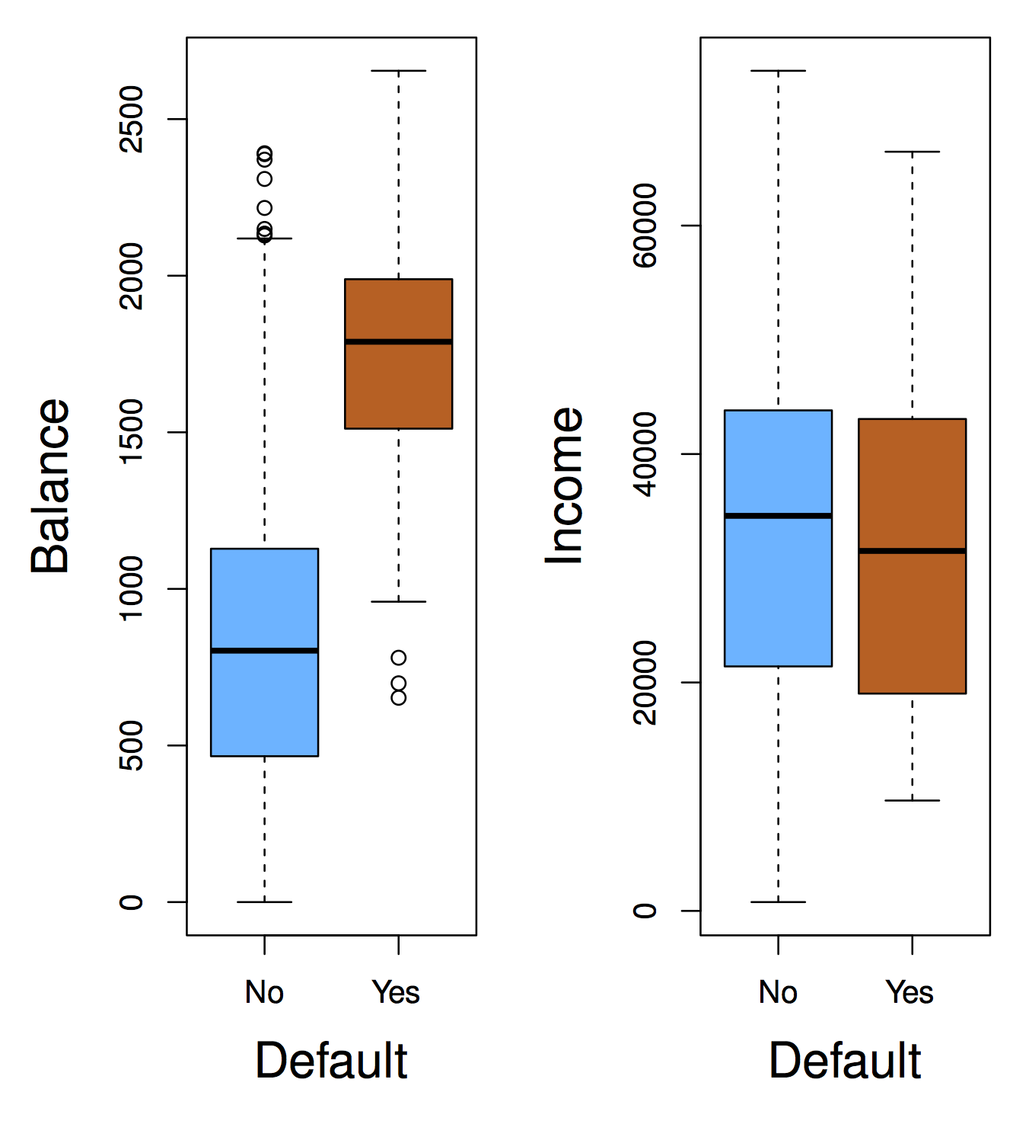
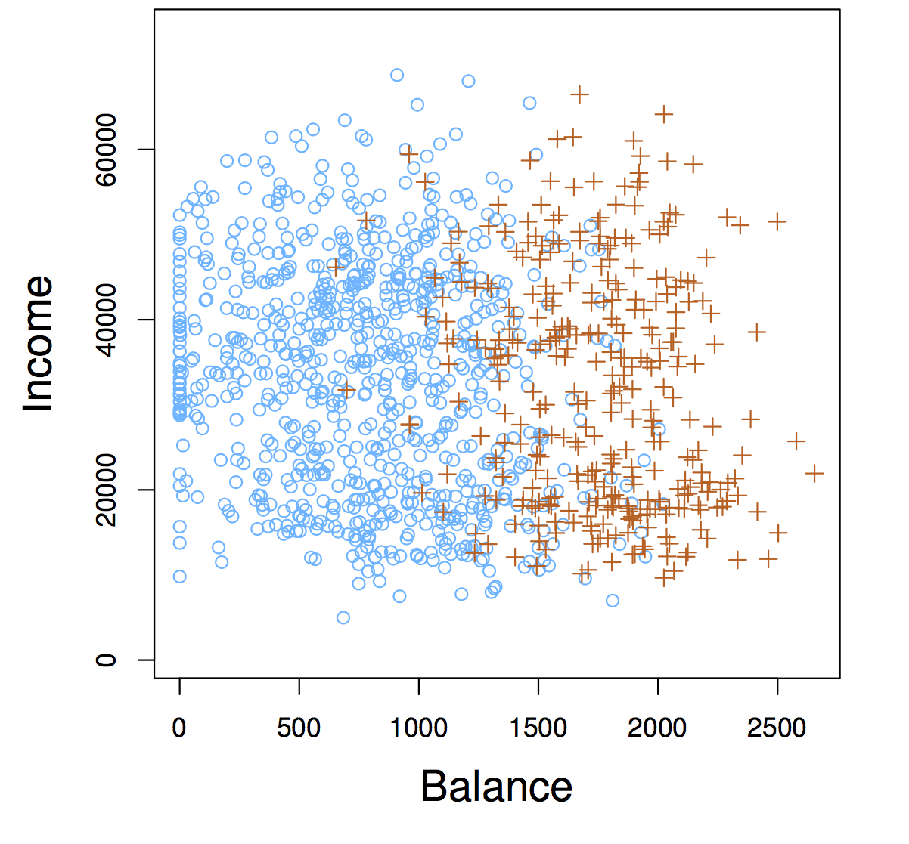
Classification: Determining Category Membership from features
Check your understanding:
Is there a meaningful relationship between Balance and Defaulting?
Is there a meaningful relationship between Income and defaulting?

Slide 9
Classification: Determining Category Membership from features
Concept Check:
Is there a meaningful relationship between Balance and Defaulting? YES!
Is there a meaningful relationship between Income and defaulting? NO

Slide 10
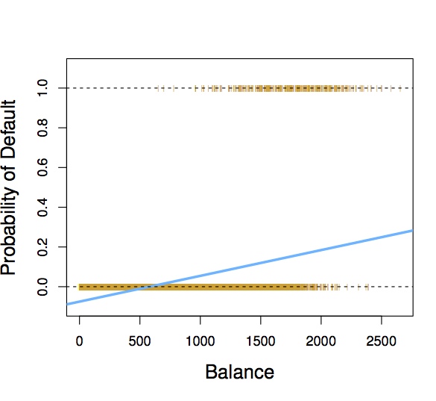
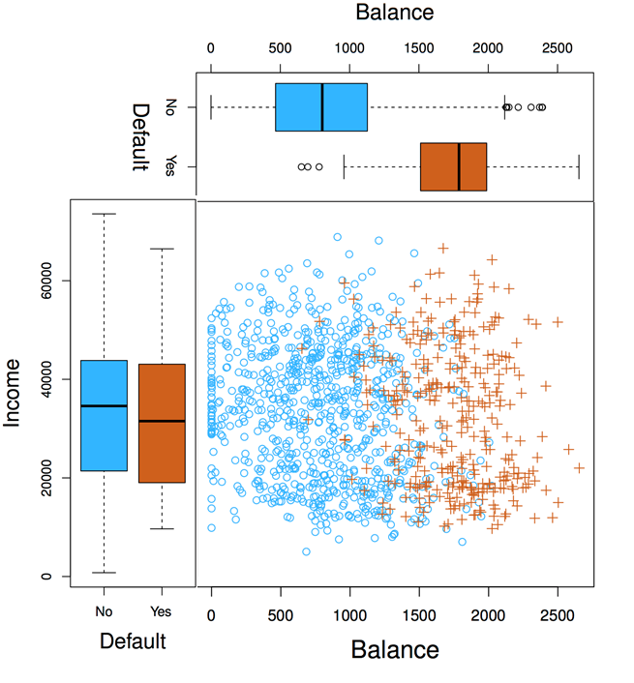
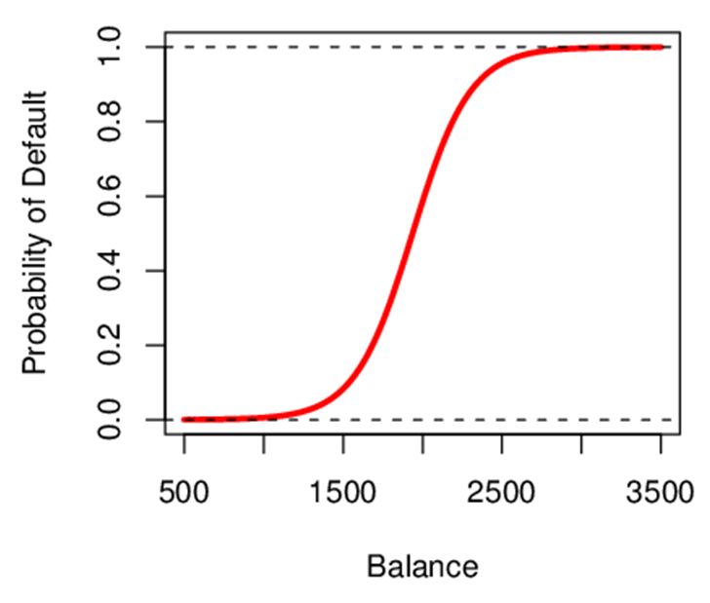

Linear Regression vs. Logistic Regression
?
$$y_{i}=β_{0}+β_{1}X_{1i}$$

Slide 11
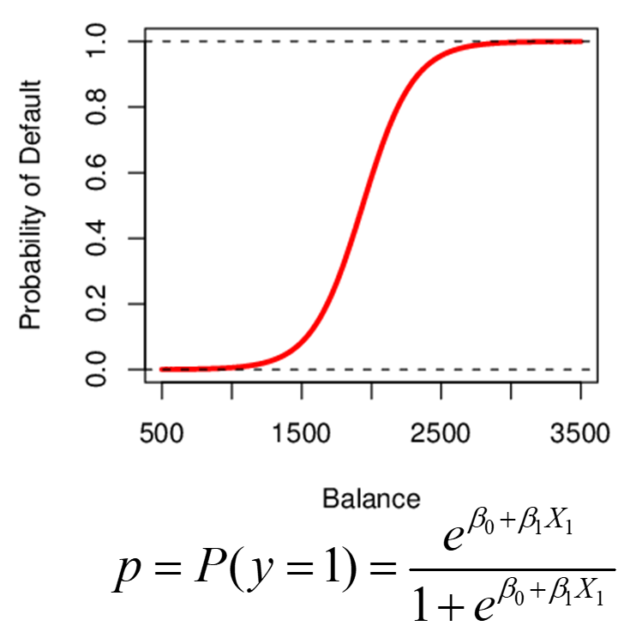
Learning Activities Overview
Logistic Function Worksheet (part 1)
Build intuition for how the parameters and logistic curve are related
Don’t use code… try to intuit it
Logistic Function Coding Activity (part 2)
Choose parameters to replicate specific shapes

Slide 12
Group Activity: Logistic Thinking
You have 10 minutes to complete the worksheet part 1 as a group

Slide 13

Logistic Function Takeaway: Interpreting β₁
Interpreting what β₁ means is not very easy with logistic regression, simply because we are predicting P(Y) and not Y
If β₁ =0, no relationship between Y and X
If β₁ >0, when X gets larger Y approaches 1
If β₁ <0, when X gets larger Y approaches 0
But how much bigger or smaller depends on where we are on the slope
Check your understanding:
How is the logistic curve altered by changing β₀ ?

Slide 14
Break

Slide 15
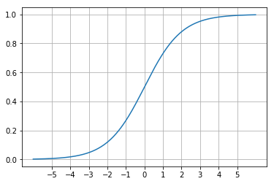
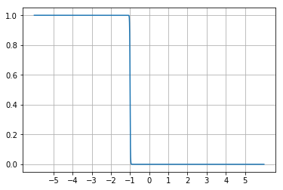
Logistic Function Part 2: Coding Practice (20 minute Group Activity)
What do you think happens to the shape of the curve as you alter the size and sign of β₀? β₁?
Obtain Code and follow directions
Write the function to compute the logistic curve
Plot the results and see what happens when you alter the betas. Does it match your intuition?
Choose values and plot a step-down function

Slide 16
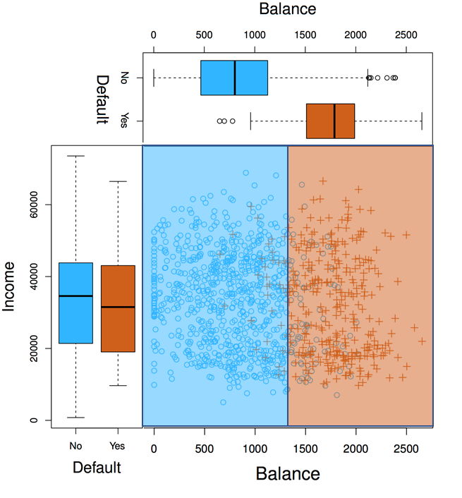
Logistic Function Activity Hotwash
What does B₁ do? What does B₀ do?
How do the signs of these affect the function shape?
How would you use this function for classification?

Slide 17
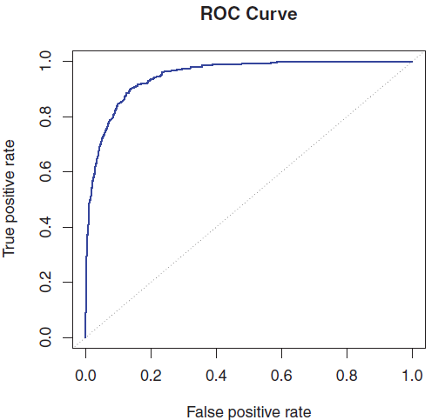
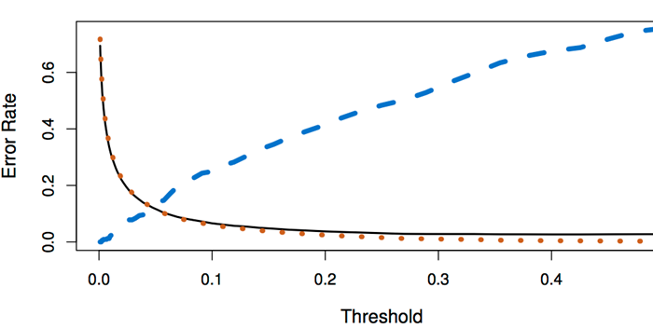
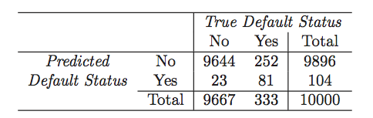
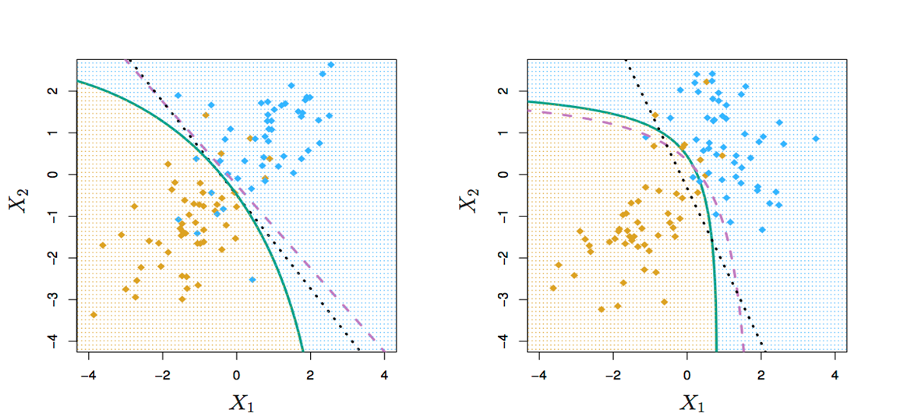
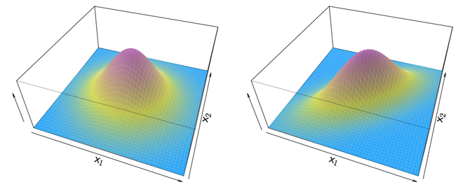
Peeking Ahead
Day 08 Activity: ROC curves
Homework 3: Performance of LogReg vs. LDA vs. QDA

Slide 18
Questions & Open Project Discussion

